Slide 1
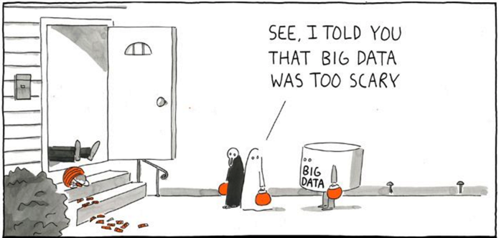
ML On Spark, UC Berkeley
Yushu Yao

Slide 2
Plans for today
Course Overview
Intro to Big Data
Intro to Spark (part I)
Hands-on
Q&A

Slide 3
Introductions

Slide 4
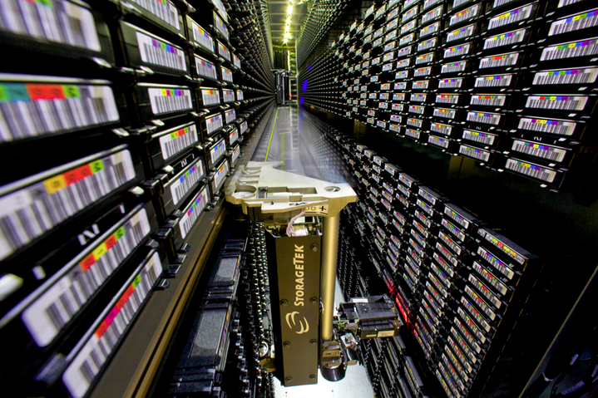


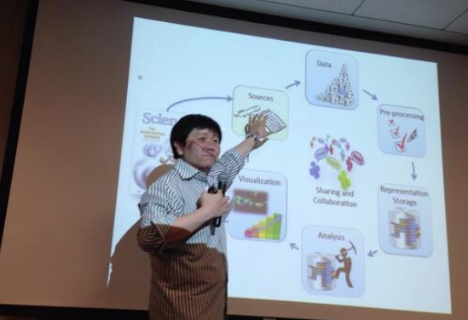
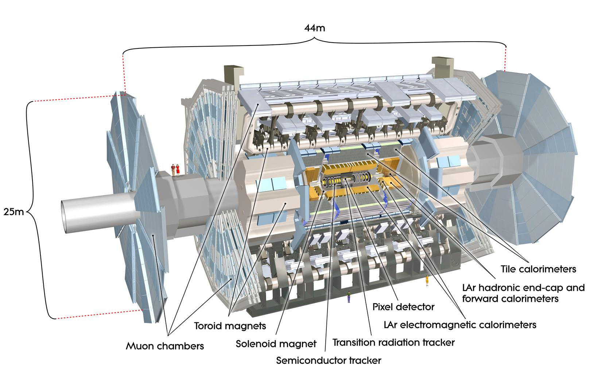

About Me
Notes:
Long history for ML (Neural networks in Grad School)
Love teaching

Slide 5
My Role
Facilitate Learning

Slide 6
Survey
Scala?
Spark?
Spark on 1K nodes?
Machine Learning?
Deep Learning?
Tensorflow? (Other DL? )
Databricks?
Spark-summit? Strata?

Slide 7
Survey
Who think AI can take over human?

Slide 9
Does intelligence come from the brain?

Slide 10
Many People Were Thinking about This ~100 years ago
Kurt Gödel proved with an incompleteness theorem that it is always possible to construct a "Gödel statement" that a given consistent formal system of logic (such as a high-level symbol manipulation program) could not prove. Despite being a true statement, the constructed Gödel statement is unprovable in the given system. (The truth of the constructed Gödel statement is contingent on the consistency of the given system; applying the same process to a subtly inconsistent system will appear to succeed, but will actually yield a false "Gödel statement" instead.) More speculatively, Gödel conjectured that the human mind can correctly eventually determine the truth or falsity of any well-grounded mathematical statement (including any possible Gödel statement), and that therefore the human mind's power is not reducible to a mechanism

Slide 11
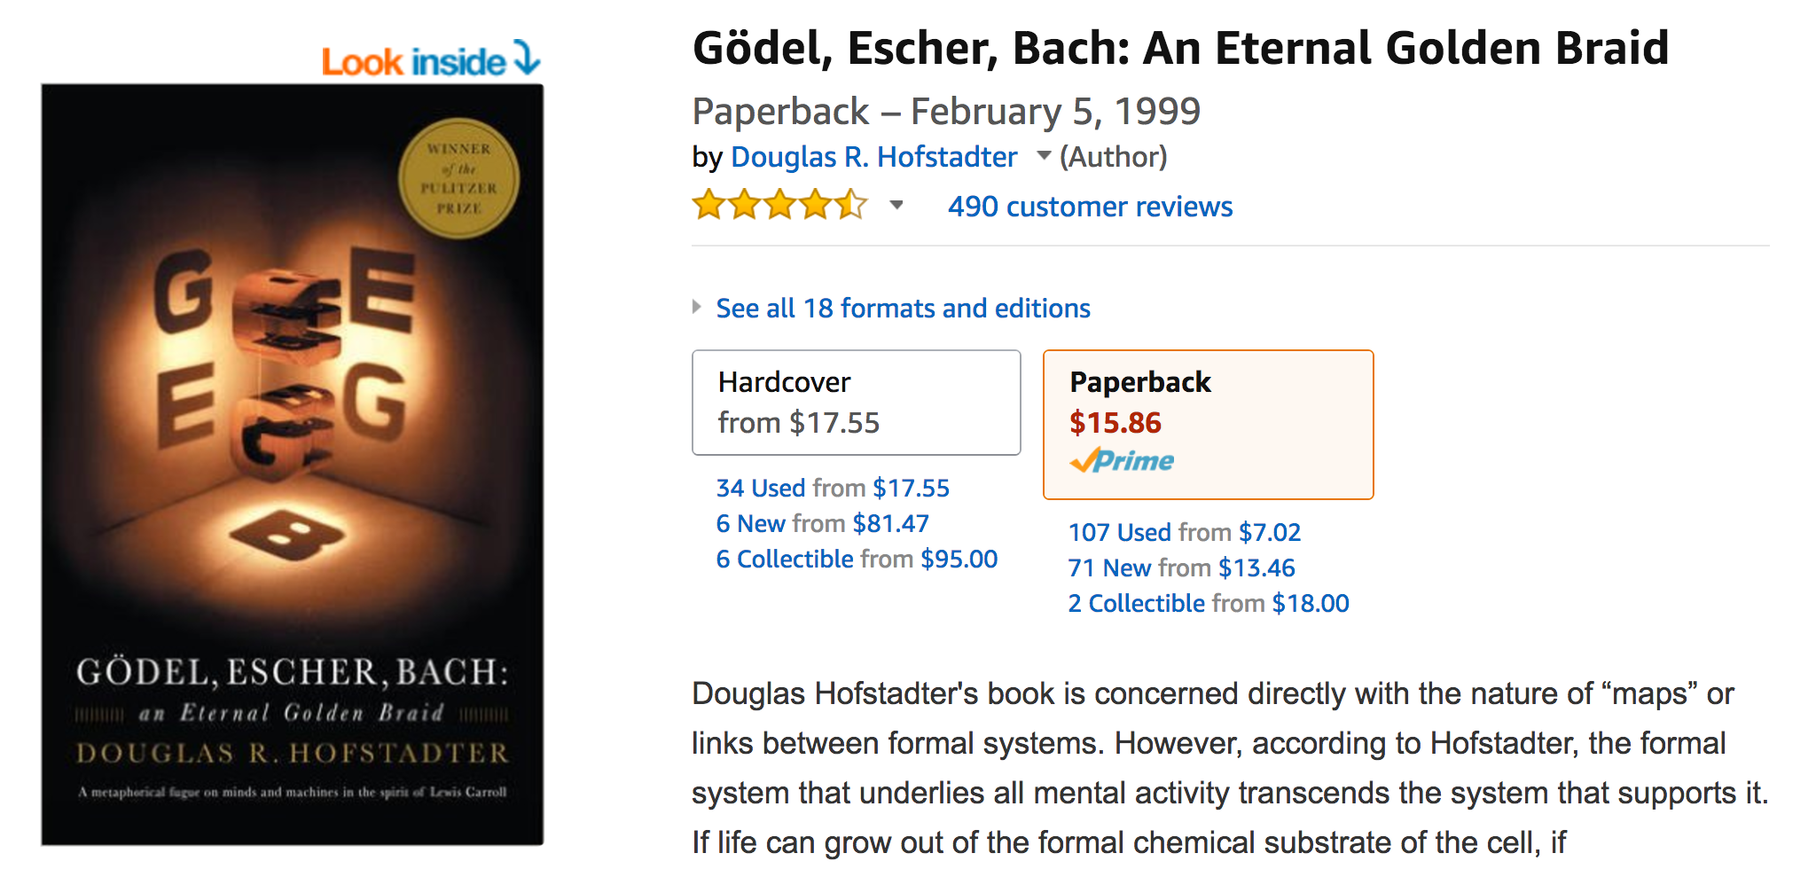
There's an MIT Class on YouTube

Slide 12
Course Overview
Prerequisites:
College Math/Stat
Some programing experience
Hands-on over theory. Example and problem solving based.

Slide 13
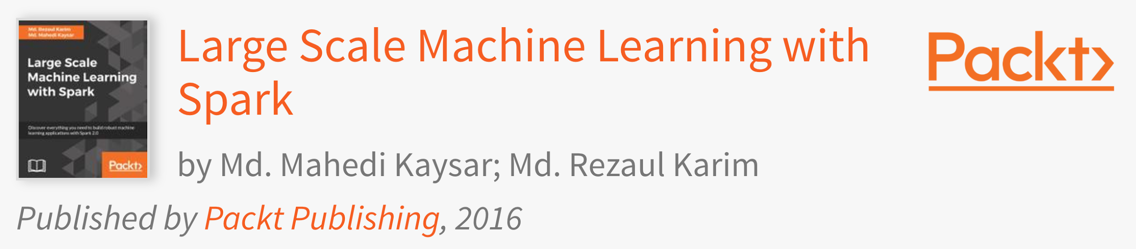
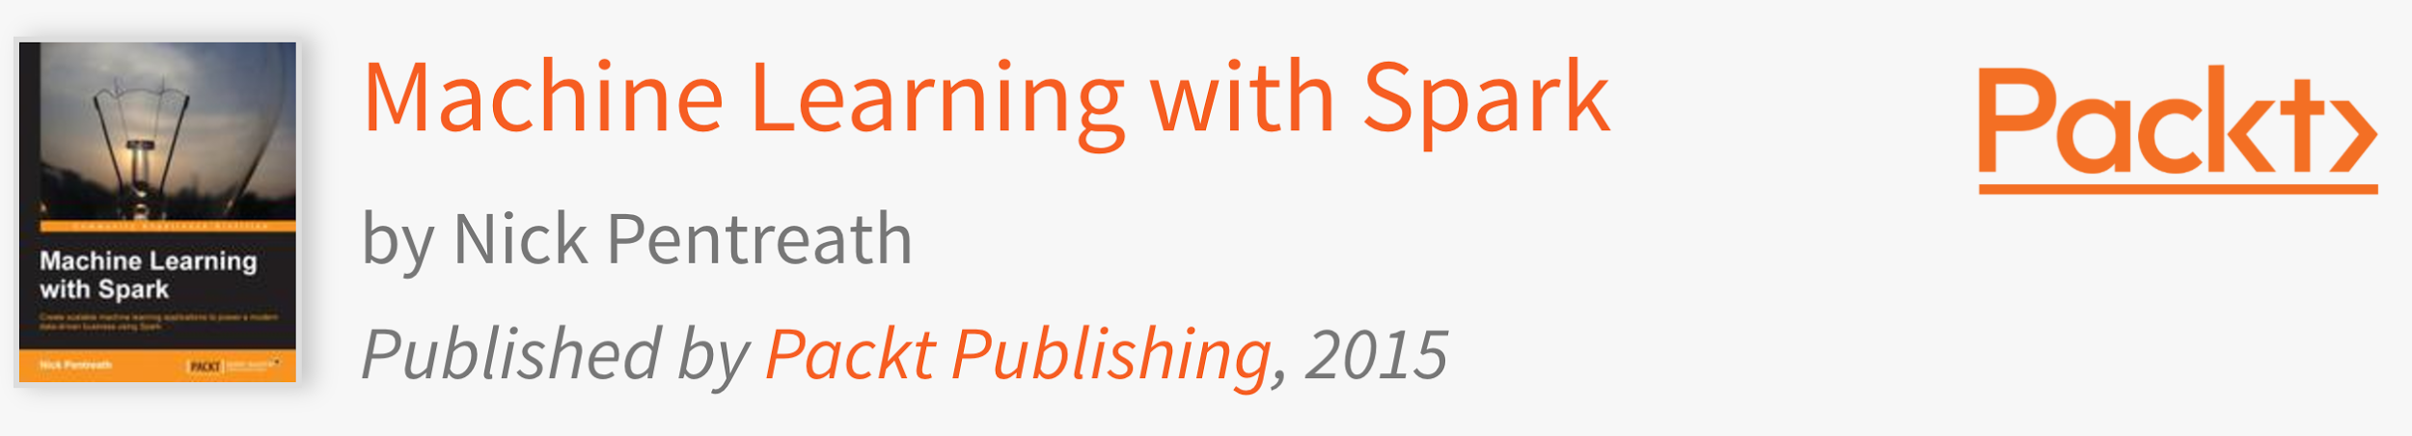
Logistics
Need a laptop in CLASS!

Slide 14
How to get Credit
In-class Quiz (Paper/Pencil, 30%)
3 Quiz
Random Time
Best 2 counts
Group Homework (30%)
Due by class start of Week 5
Final Group Project (40%)
Due by the Last Class
10-Minute presentation per group Last class
Obtain 60% overall to pass!
Option to do Letter Grades or Pass/Fail (Google it!)

Slide 15
Student Talks Welcome
What's happening in your organization?
Motivate others!
Be Technical!
No Company Secret!

Slide 16
Study Groups
6 person groups (8 groups).
Form groups before Week 3 class!
Before you form the group:
Write Self-intro and Project Pitch
After you form the group:
Write down the details in the signup sheet

Slide 17
Gmail Account
Need your gmail account so that I can share with you the slides and course document.

Slide 18
Focus of the course
Basic Machine Learning Techniques
Experience the techniques with Spark/MLLib
Why not an online course?
Enjoy the party!

Slide 19
Load?

Slide 20


Slide 21

What have you heard about Big Data?

Slide 22
The 4 Vs of Big Data

Slide 23
The 4 Vs of Big Data
Velocity
Volume
Variety
Verocity

Slide 24
The 4th Paradigm

Slide 25
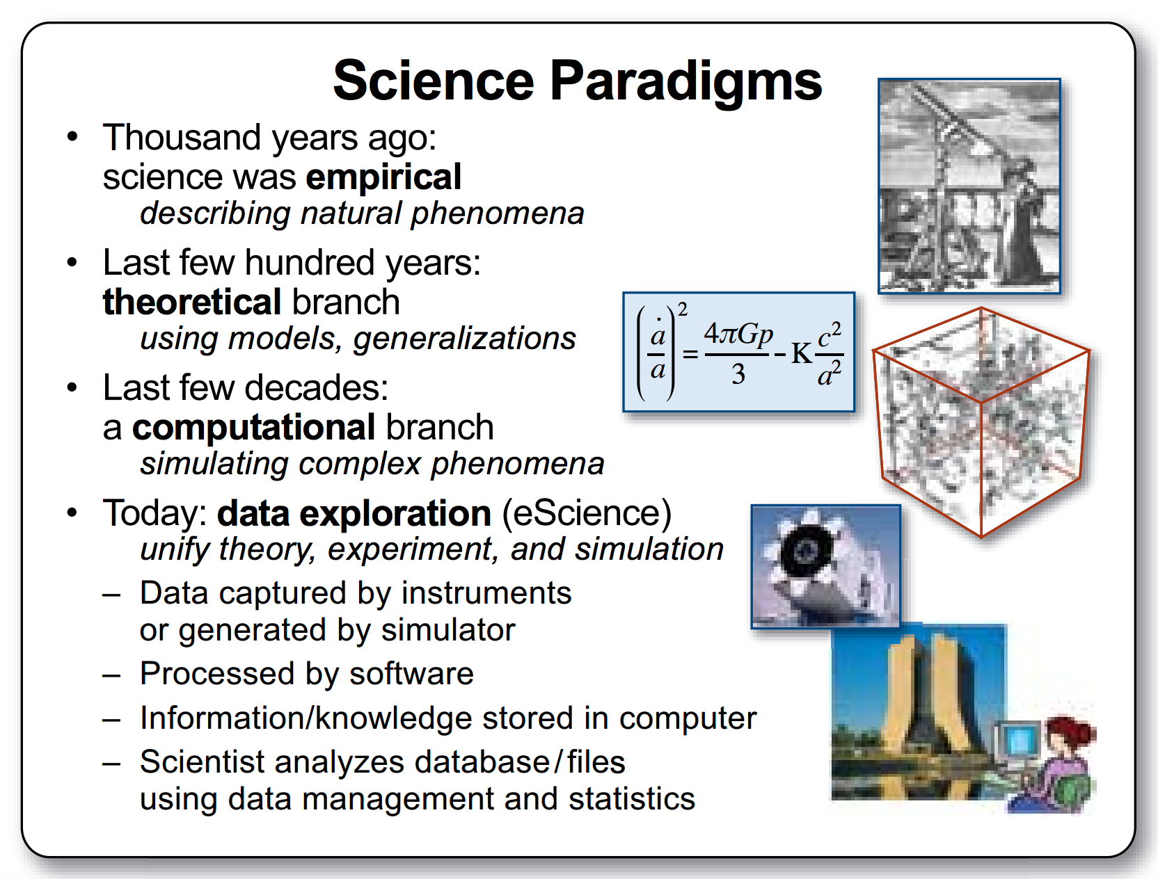

Slide 26
Why Big? The More the Merrier?

Slide 27
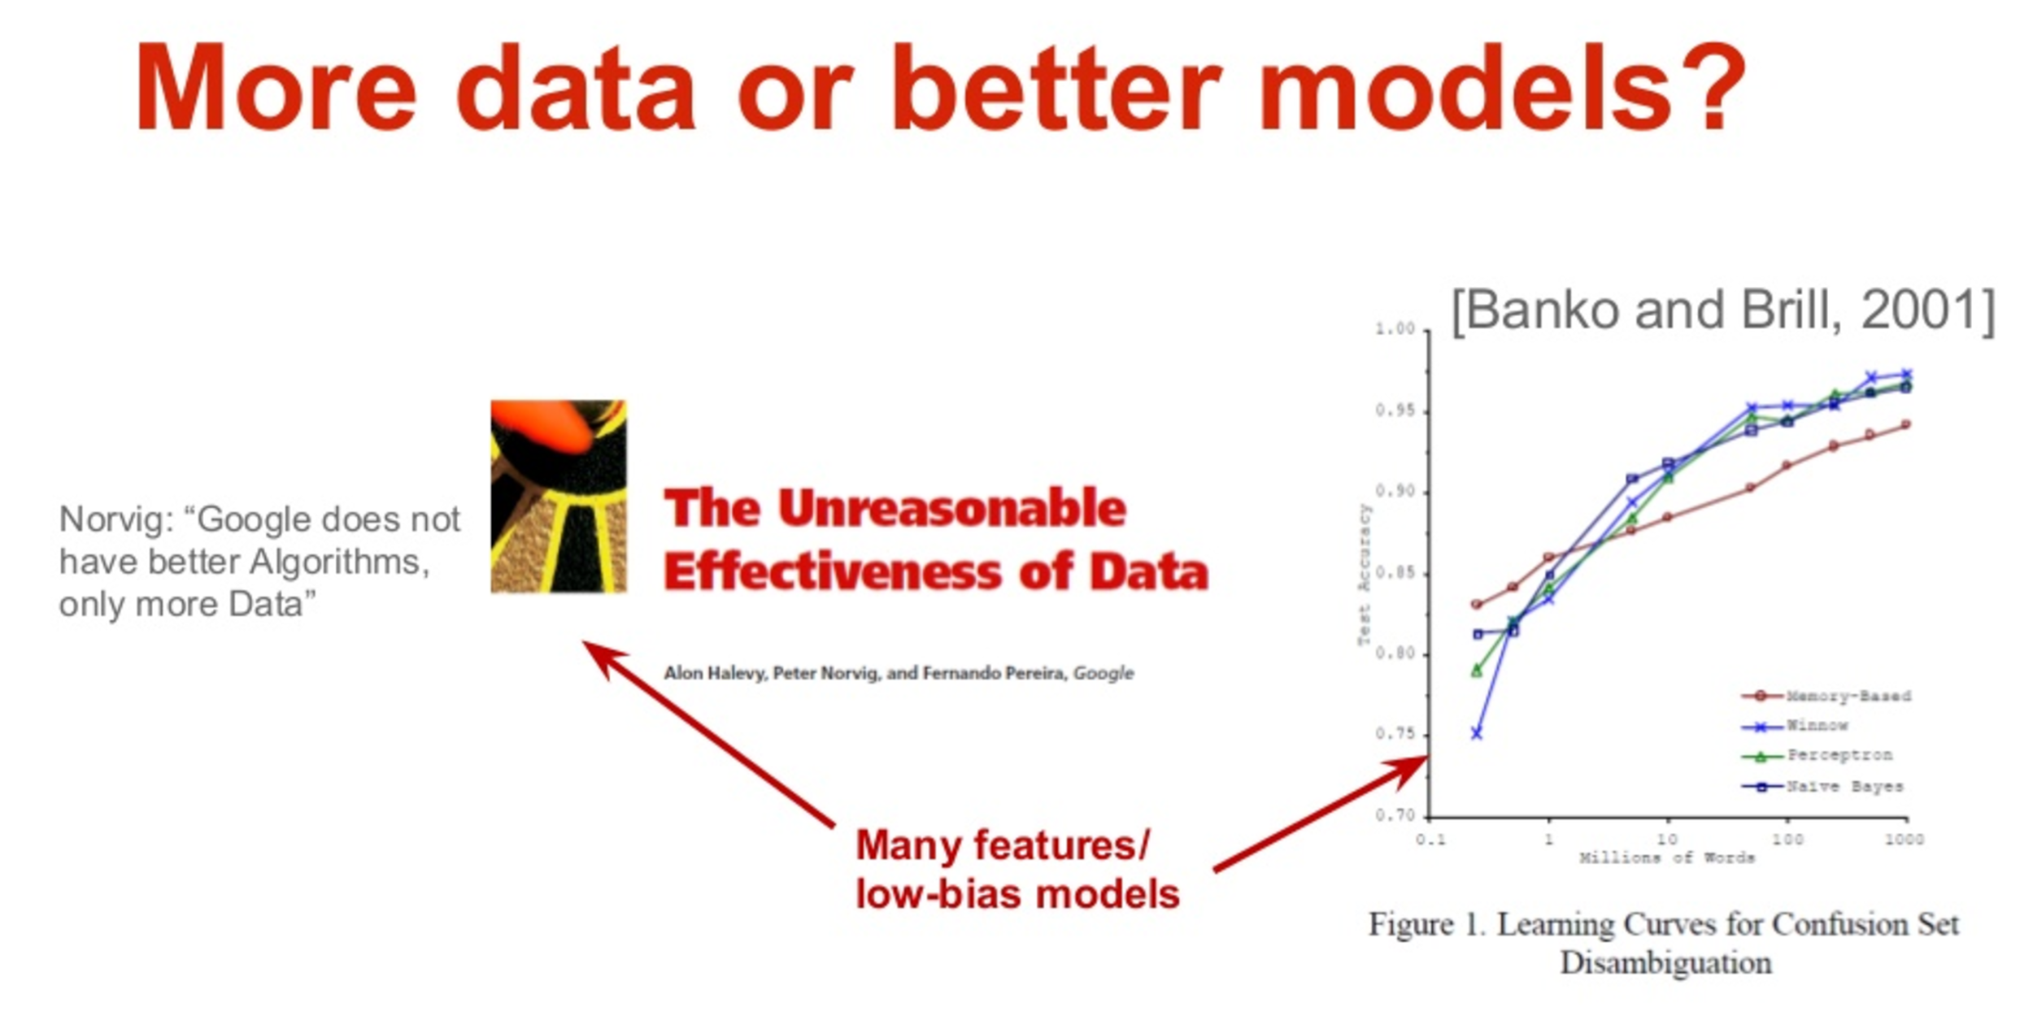
Yes
The Unreasonable Effectiveness of Data
Scaling to Very Very Large Corpora for Natural Language Disambiguation
Notes:
Reading: http://www.kdnuggets.com/2015/06/machine-learning-more-data-better-algorithms.html

Slide 28
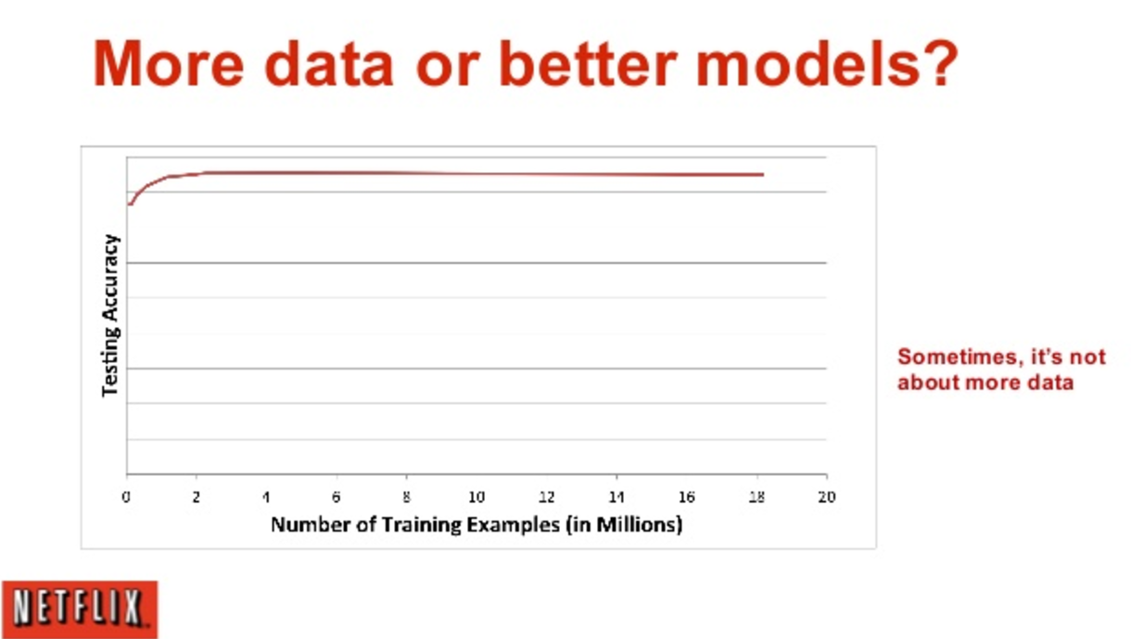
No
Notes:
Reading: http://www.kdnuggets.com/2015/06/machine-learning-more-data-better-algorithms.html

Slide 29

What is the Data Science Process?
Now What

Slide 30
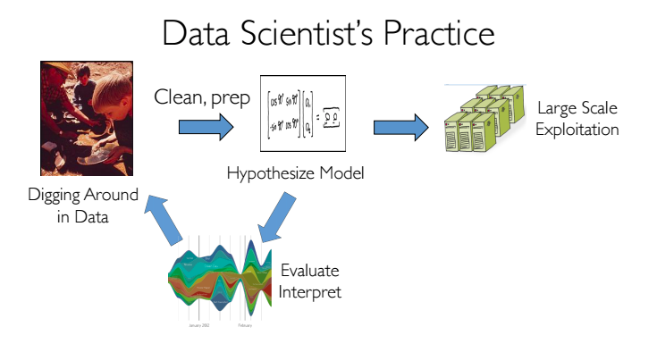
Data Science Practice
Graph courtesy of CS100.1x EdX

Slide 31

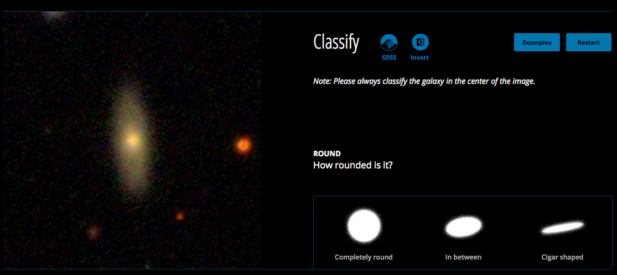
A Science Use Case
1st year. 50 million classifications, 150,000 people

Slide 32

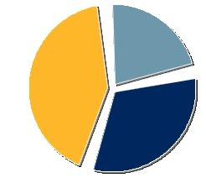

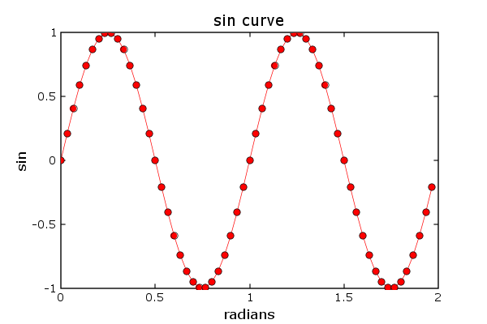
Recap - Big Data
Source of Data
The Data Science Workflow
Analysis
Refined/New Analysis
Terabytes of Data
Scientific Insight

Slide 33
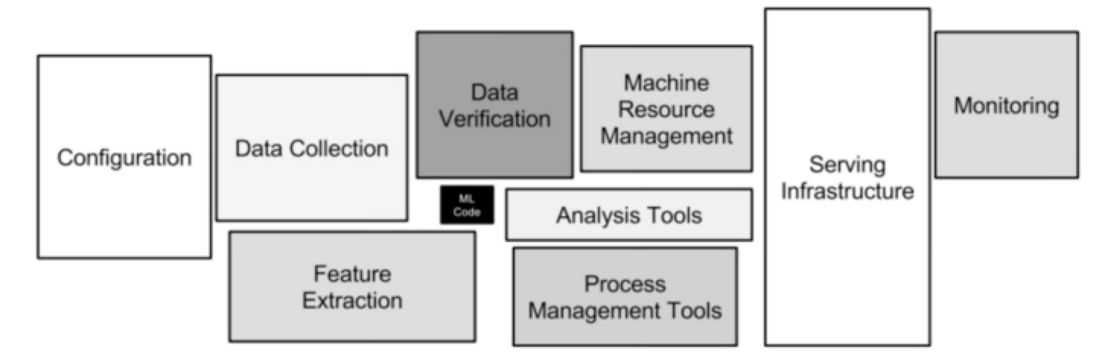
The big data eco-system
Not only the black box in the middle, for it to be useful in industry scale, need to figure out all of the other

Slide 34
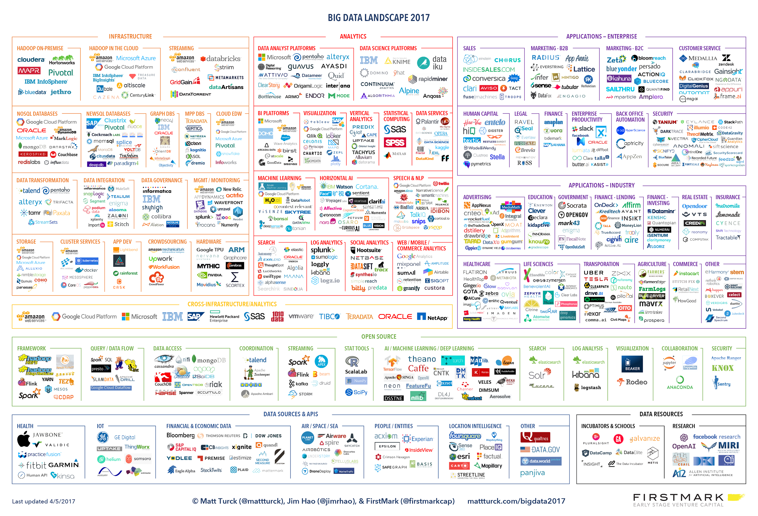

Slide 35
Getting Started with Spark

Slide 36
The Word Count Problem

Slide 37
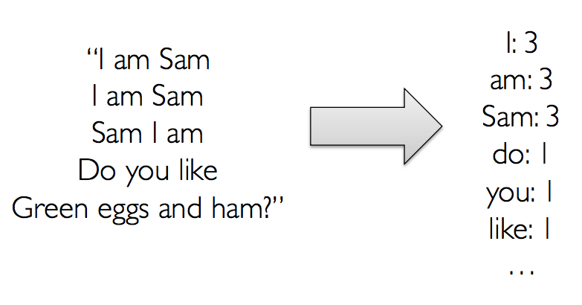
The Word Count Problem

Slide 38
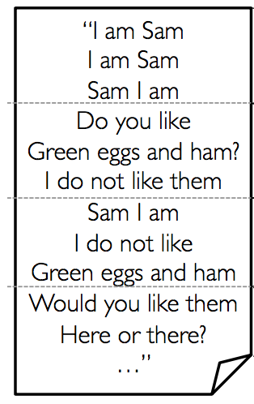
What if the document is big?
Notes:
Mark number of machines

Slide 39
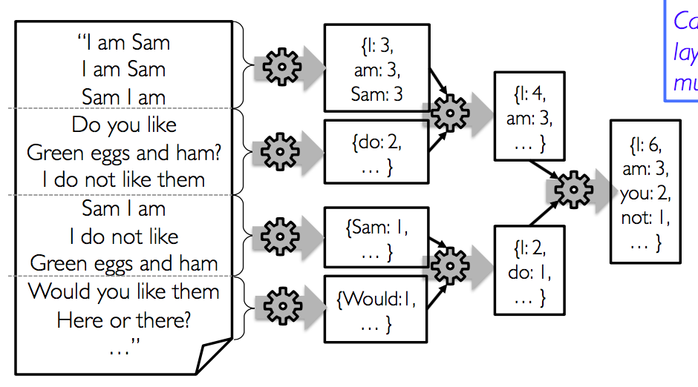
Problem with Layered Aggregation

Slide 40
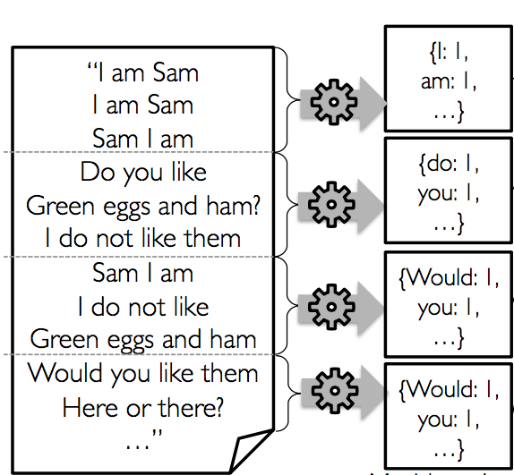
How to divide and conquer

Slide 41
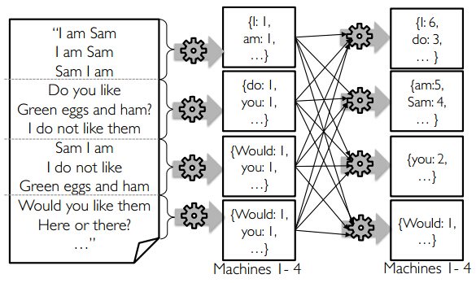

Slide 42
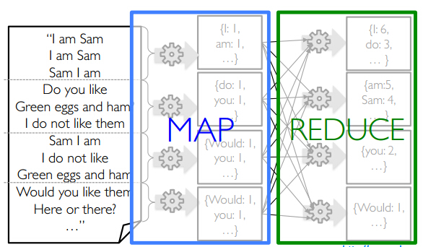
Map-Reduce

Slide 43
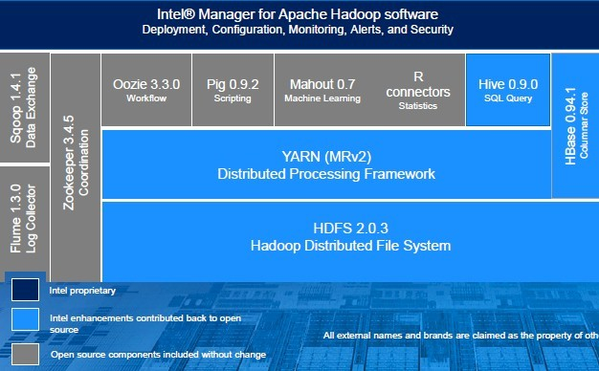
Hadoop Stack (One version of it)

Slide 44
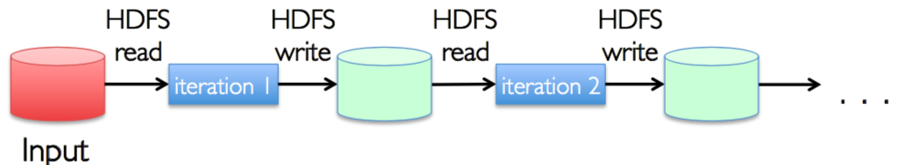
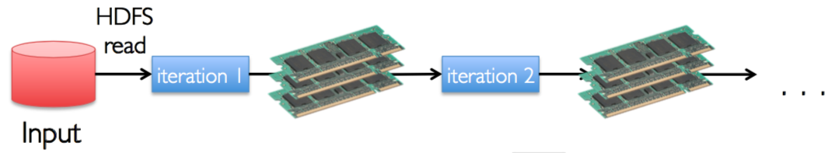
From Hadoop to Spark

Slide 45
RDD (what Dataset?)
Distributed
Resilient

Slide 46
Spark Framework
Transformations
Actions

Slide 47
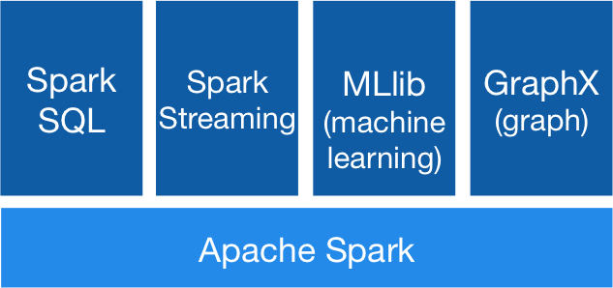
Spark Stack

Slide 48
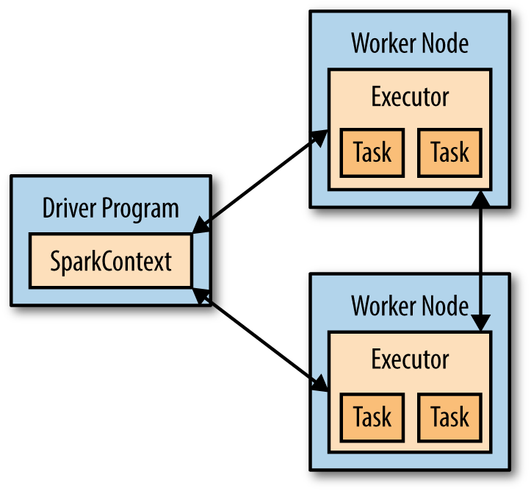
Spark Distributed Execution Model

Slide 49
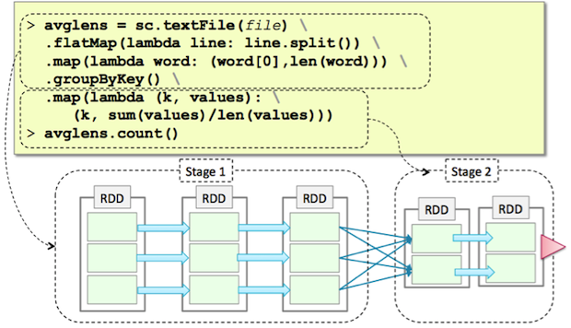
Execution Plan

Slide 50
Databricks Access

Slide 51
Best way to work on the assignment/project?
Create a community account for your group to share.
DO NOT use Public GitHub Repo
if you check-in the AWS credentials into a public repo, Amazon will find out and disable it.

Slide 52
Hands-On

